Slide 1
Digital portfolio
Student name: devisri Ravi
Register no and nmid: 31AF81E79D14242BBEA4F19F757CDAB4
Department: bachelor of application,II year
College/University: shree raghavendra arts and science college
annamalai University

Slide 2
Project title
_{Digital Portfolio:}
A digital portfolio is an online collection of a person’s work, skills, achievements, and projects, usually used to showcase talent for education or career opportunities
It can include documents, images, videos, presentations, and links that highlight personal or professional growth.

Slide 3
Agenda
Problem statement
Project overview
End user
Tools and technologies
Portfolio design and layout
Features and functionality
Results and screenshot
Conclusion
GitHub link

Slide 4
Problem statement
“Traditional resumes are not enough to showcase practical skills and creativity. There is a need for a digital portfolio that presents projects, achievements, and talents in an interactive and professional way.”
The Website should:
The website should be user-friendly and easy to navigate.
The website should be responsive (work on mobile, tablet, and desktop).
The website should be secure and protect user data

Slide 5
Project overview
Project overview: Digitalal portfolio website
Project tittle: personal digital portfolio – Devisriravi(BCAstudent)
Objective:
The objective of a digital portfolio is to showcase an individual’s skills, achievements, and projects in an organized online format. It aims to highlight personal and professional growth, making it easier for employers, educators, or clients to evaluate abilities.

Slide 6
Project overview
3.Key features:
Showcase of Work – Projects, assignments, designs, or achievements
Personal Information – Name, contact details, and brief bio.
Skills and Competencies – Technical, creative, or professional skills.
Interactive Design – Easy navigation and user-friendly interface.
Professional Presentation – Clean, organized, and visually appealing.

Slide 7
Project overview
4.Technologies used:
HTML5 – website structure
CSS3 – styling and layout design
JavaScript – Interactivity(photo preview,menu toggle, contact form)
Front awesome icons for better visual appeal

Slide 8
Project overview
5.Expected overcome
Present projects and skills in an organized manner.
Improve opportunities for jobs, internships, or academic recognition.
Make work easily accessible to viewers.

Slide 9
Who are the end user
Employers/Recruiters – To assess candidates for jobs.
Teachers/Educators – To evaluate academic progress.
Clients/Customers – To check previous work before assigning projects.
Peers/Colleagues – For collaboration and inspiration.
Professional Communities – For networking and skill recognition.

Slide 10
Tools and techniques
Tools used:
1. HTML – To structure the content of the portfolio (headings, text, images, links).
2. CSS – To style the portfolio (colors, fonts, layouts, responsiveness).
3. JavaScript (JS) – To add interactivity (animations, buttons, forms, navigation menus).
4. Code Editor – VS Code / Sublime Text for writing code.
5. Browser Developer Tools – For testing and debugging the portfolio.

Slide 11
Tools and techniques
Techniques used:
Semantic HTML – Using proper tags for clarity and SEO.
Responsive Design with CSS – Making portfolio mobile-friendly.
Styling Techniques – Flexbox, Grid, transitions, and animations.
4. JavaScript DOM Manipulation – To make dynamic changes (show/hide content, image sliders).
5. Form Validation – Using JavaScript for input checks (e.g., contact forms).

Slide 12
Portfolio Design and layout
Design:
Simple & Clean Layout – Easy to navigate and understand.
Visuals & Multimedia – Use images, videos, and graphics to make it engaging.
Professional Look – Should highlight creativity and expertise.
User-Friendly Navigation – Clear menu, easy to move between sections.
Minimal Loading Time – Optimize images and code for fast performance.

Slide 13
Portfolio design and layout
Layout:
Header Section – Name, title, logo, and navigation menu.
Skills Section – List of technical and soft skills.
Projects/Work Section – Showcase of best projects with details.
Contact Section – Email, phone, LinkedIn, GitHub, or social links.
Footer – Copyright, quick links, and credits.

Slide 14
Features and functionality
Features:
Skills Section – Technical, creative, and soft skills.
Educational Details – Academic background.
Responsive Design – Works on mobile, tablet, and desktop.
Professional Design – Clean, attractive, and modern look.
User-Friendly Navigation – Clear menus and easy browsing.

Slide 15
Features and functionality
Functionality:
Highlight Skills – Categorize technical, creative, and soft skills.
Responsive Layout – Works on mobile, tablet, and desktop.
Multimedia Support – Images, audio, video, presentations, and documents.
Social Media Integration – LinkedIn, GitHub, or other professional links.
Feedback Section – Clients/teachers can leave comments or reviews.

Slide 16
Results and screenshot
Results:
These show how effective the portfolio is in showcasing skills, projects, and professional growth.
Allows teachers, clients, or peers to provide reviews/testimonials.
Shows progress over time through updates and new projects.
Coding, design, or multimedia skills are showcased effectively.

Slide 17
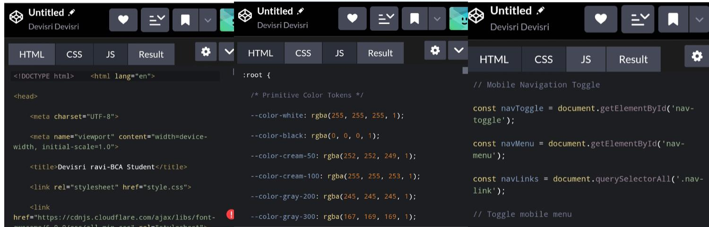
Screen shot
Devisri Ravi
BCA student |shree raghavendra arts and science college
Keezhamoongiladi, Chidambaram, Cuddalore, Tamil Nadu, India.

Slide 18
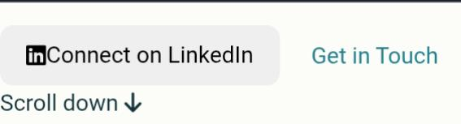
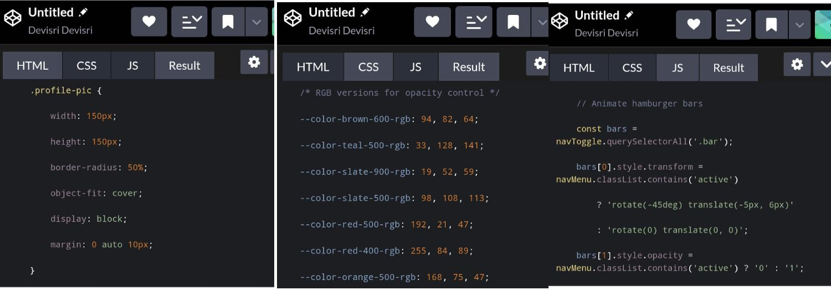
Screenshot

Slide 19
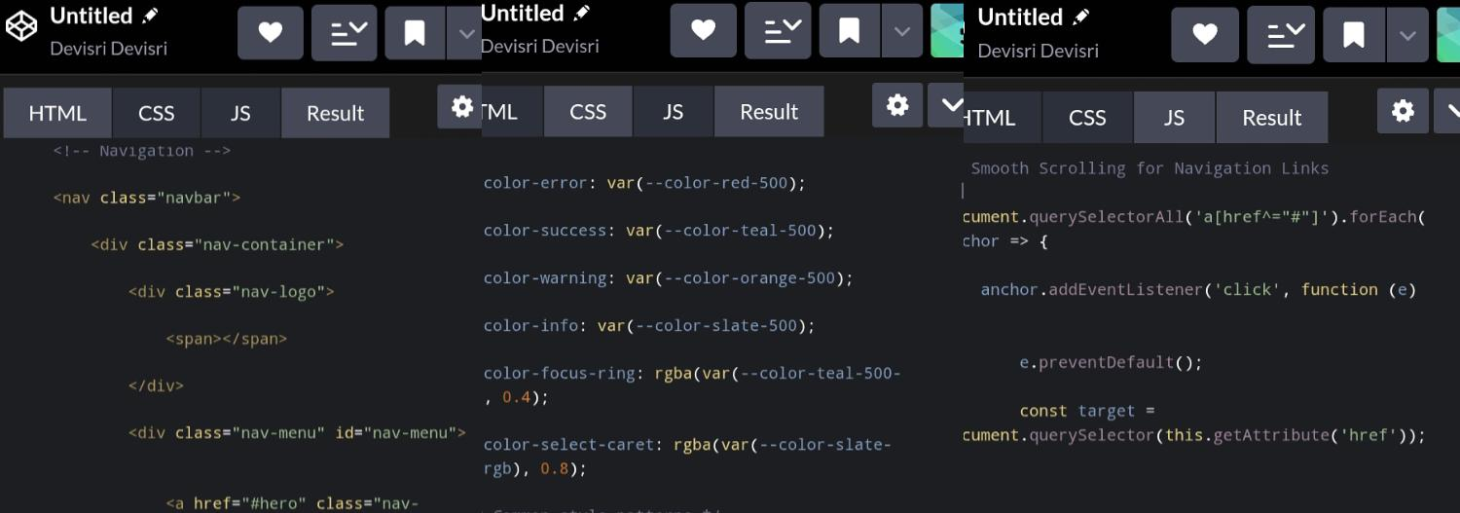
Screenshot
About Me
Computer applications student at shree raghavendra arts and science college.

Slide 20

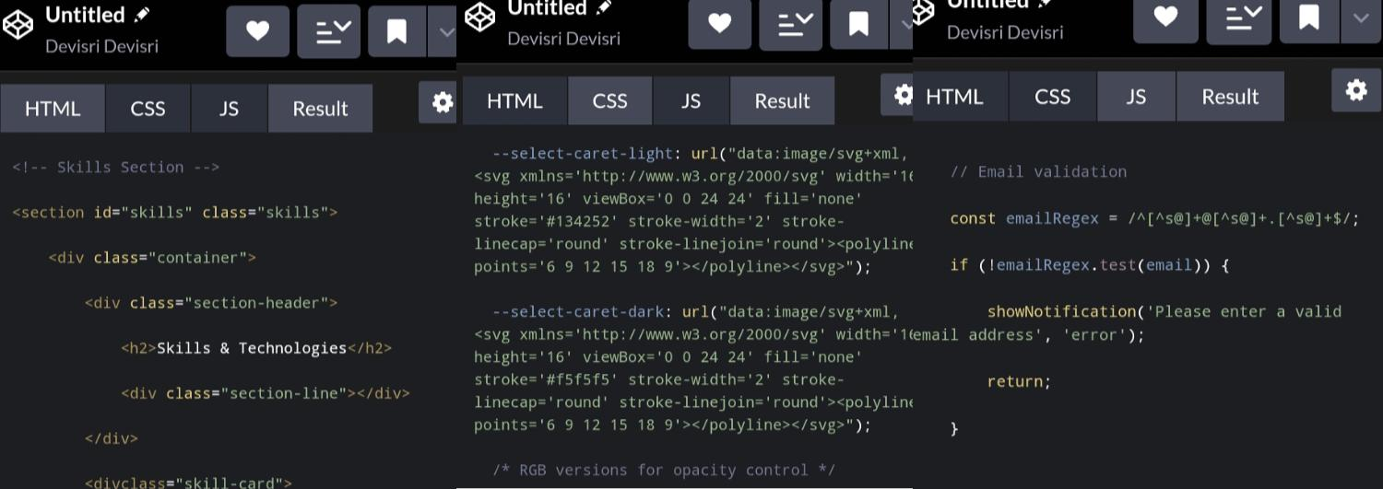
Screenshot

Slide 21
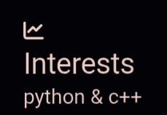
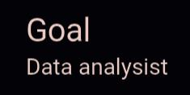
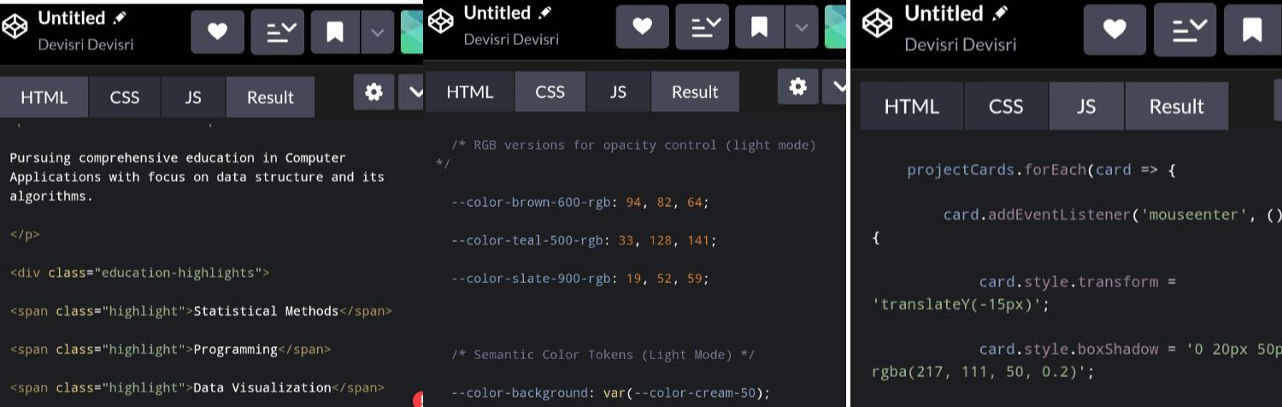
Screenshot

Slide 22
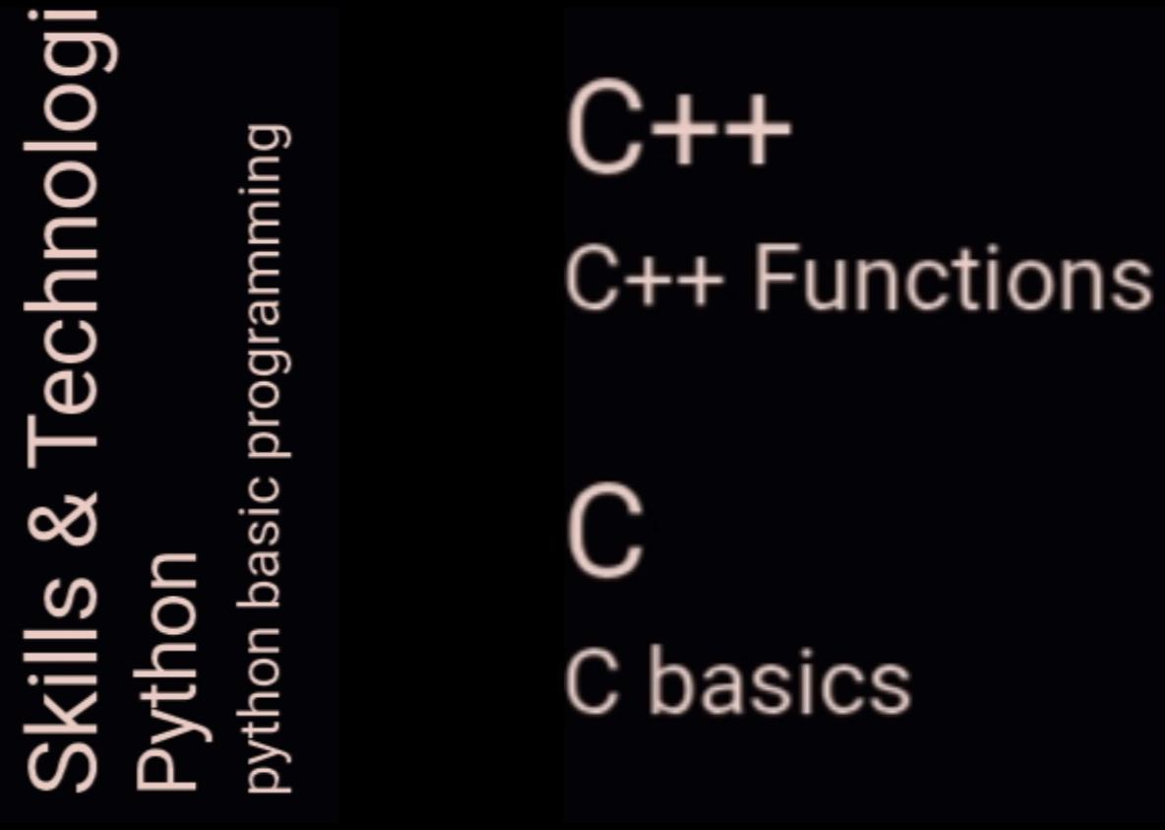
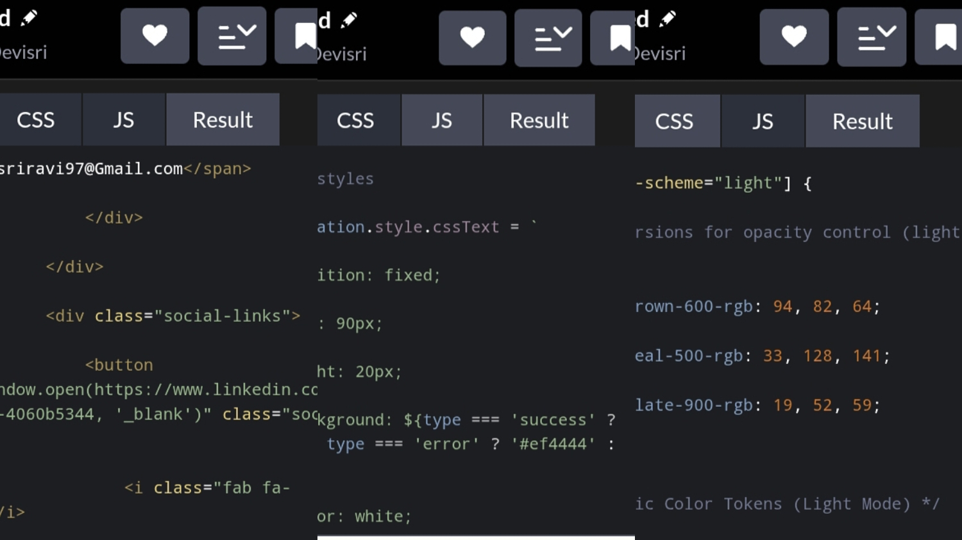
Screenshot

Slide 23
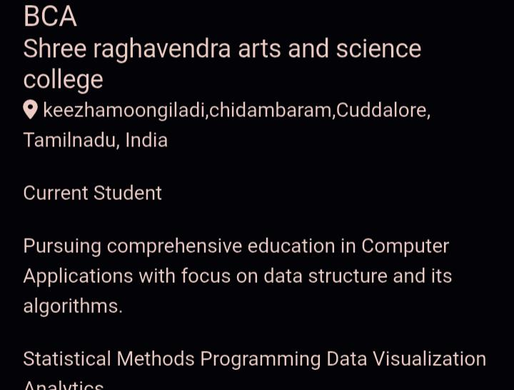
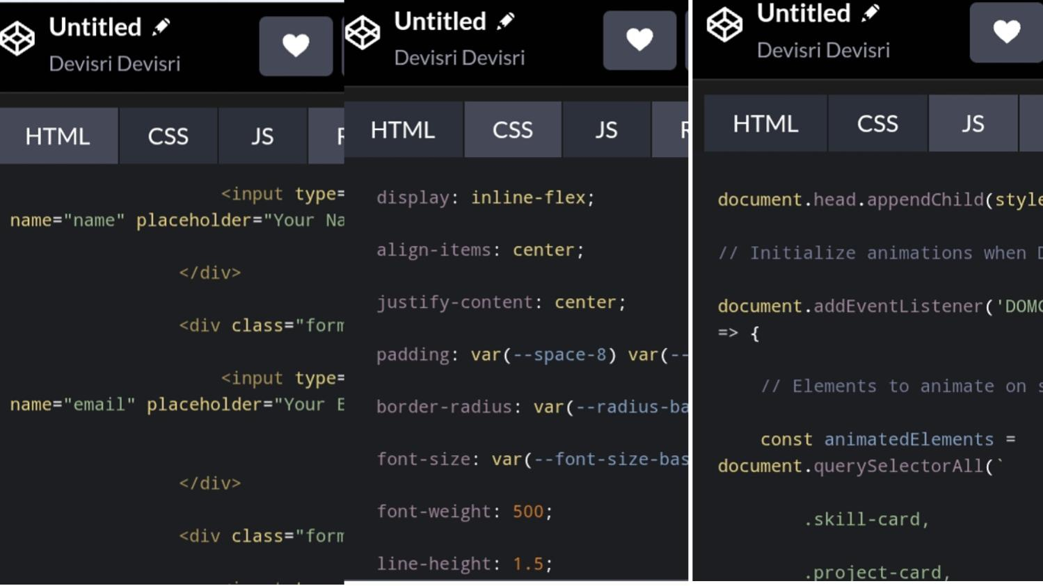
Screenshot

Slide 24
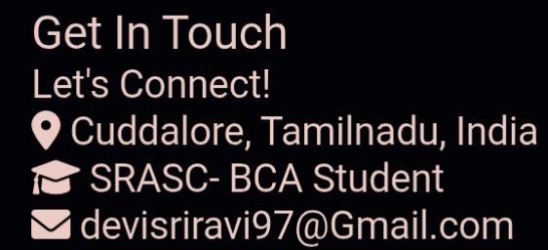
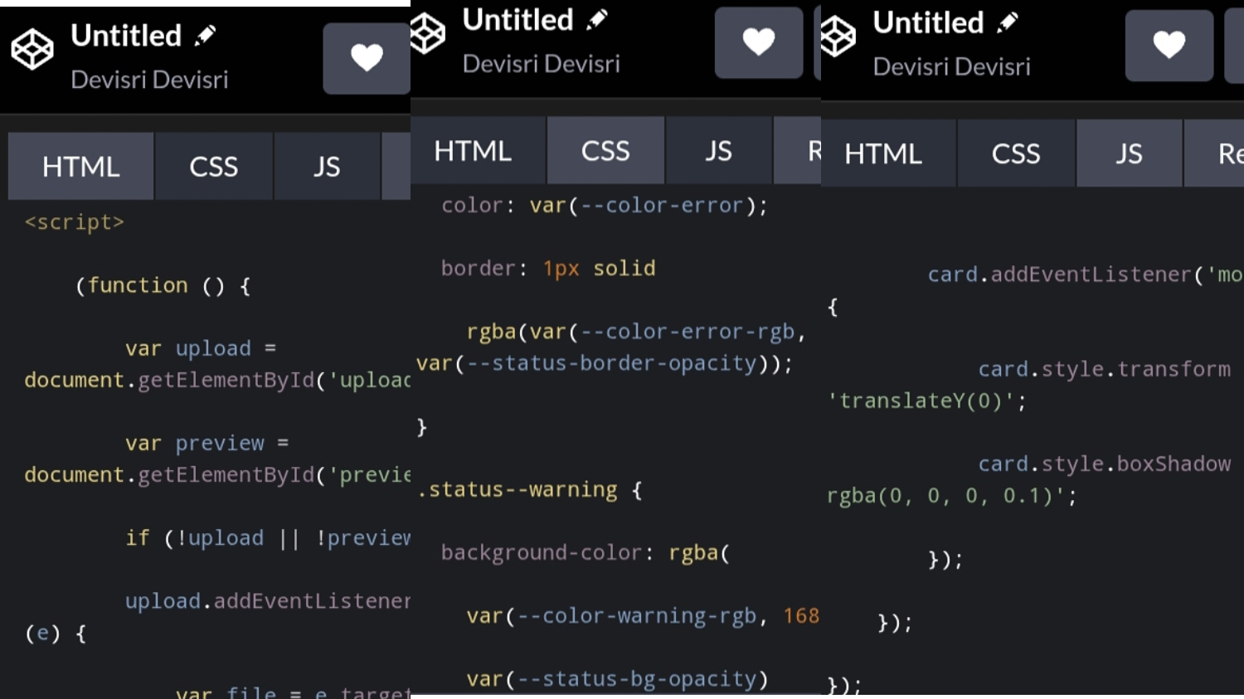
Screenshot

Slide 25
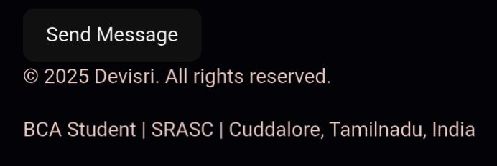
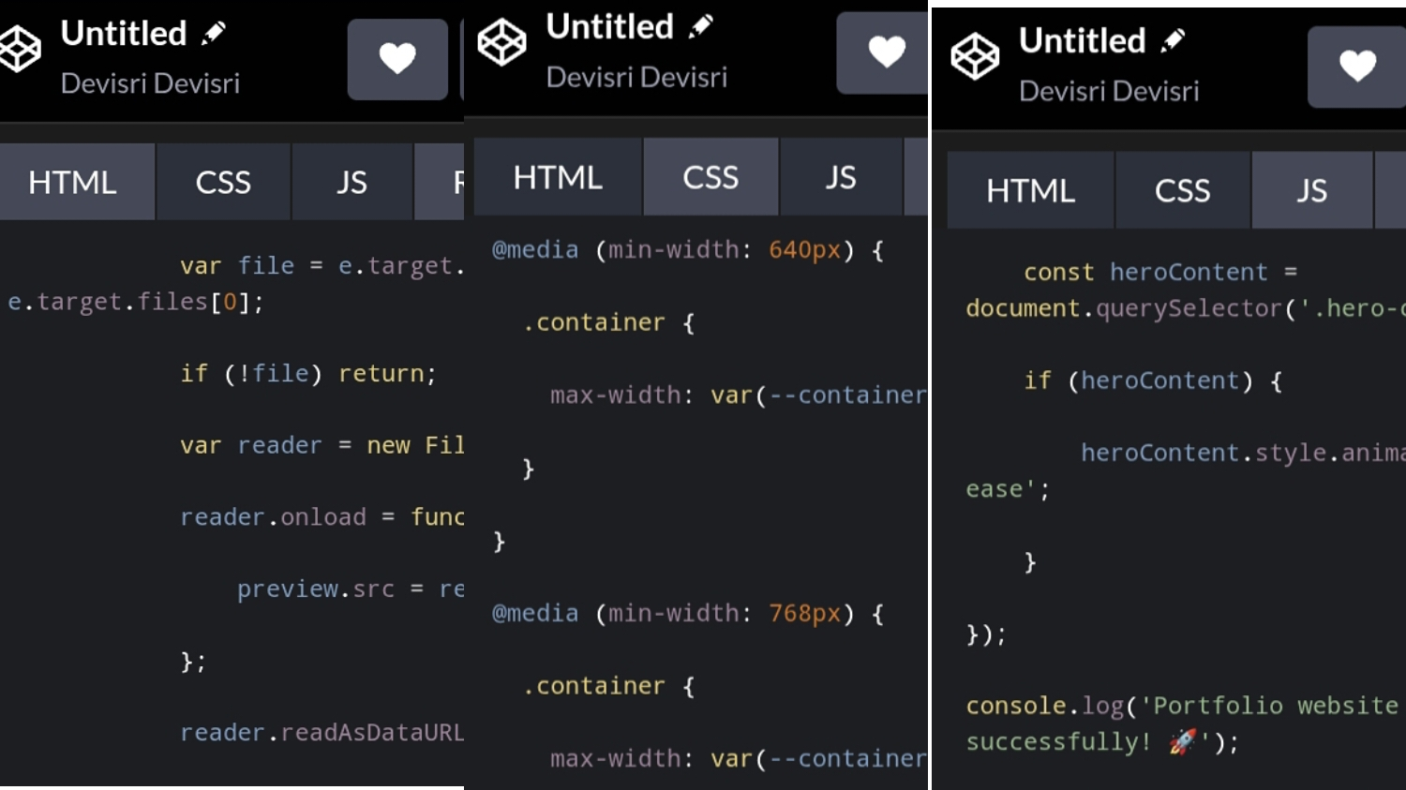
Screenshot

Slide 26
Conclusion
Conclusion of digital portfolio:
Showcases skills, talents, and achievements effectively.
Helps in career opportunities and higher studies.
Easy to share and accessible anytime, anywhere.
Builds credibility and professional image.
Enhances confidence and self-presentation skills.
By integrating modern technologies like HTML, CSS, and JavaScript, the portfolio becomes interactive and user-friendly, making it easier for potential employers, educators, or clients to evaluate capabilities.

